Slide 1
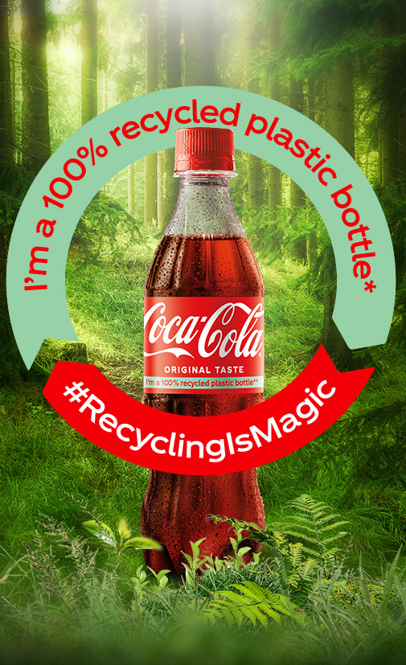
Coca-Cola's ESG
Refresh the World
Make a Difference
Team Company: Coca-Cola
Team Member: Chendong Yao, Fulei Zhang, Jiahao Zhang, Lingzhi Cao, Yilin Jiang
Team Name: Singapore
Date: 2024.6.13

Slide 2
Table of Contents
1. Introduction
2. Environmental initiatives
3. Social responsibilities
4. Governance & Ethics
5. Sustainable Growth Metrics
6. Conclusion & Future

Slide 3
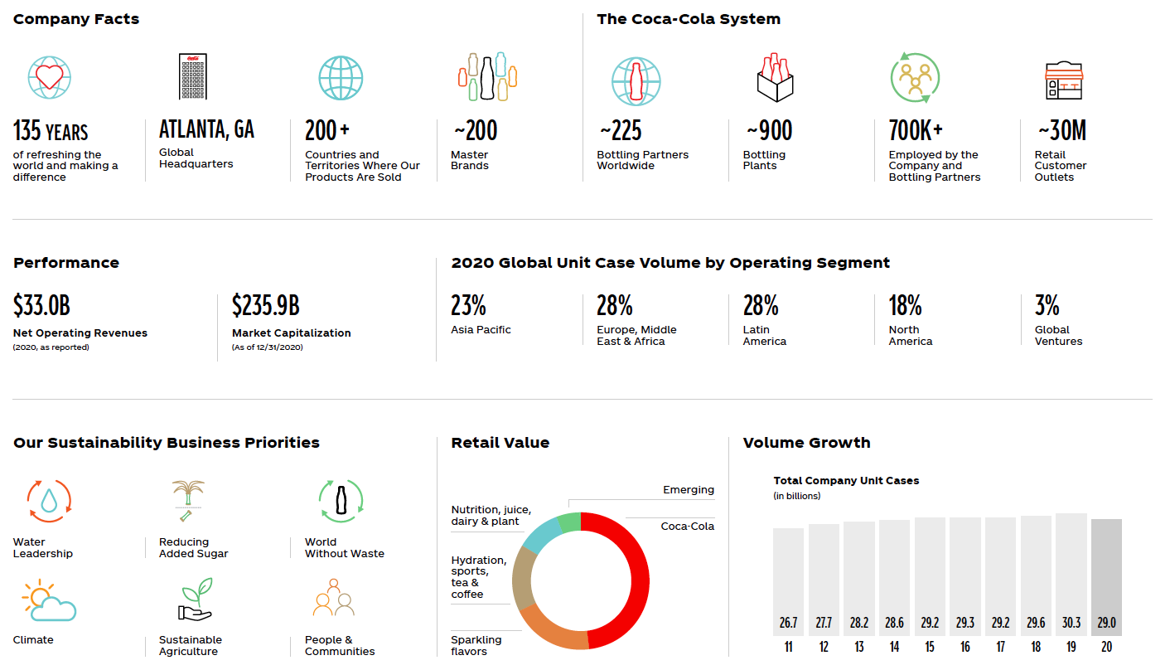
Introduction

Slide 4

Objective: Drive systemic change through a circular economy for packaging.
Environmental initiatives
Objective: Drive systemic change through a circular economy for packaging.
Recyclable Packaging
1
100% recyclable globally by 2025
2
Recycled Content
50% recycled material by 2030
Bottle and Can Collection
3
Collect and recycle a bottle/can for each one sold by 2030

Slide 5


Environmental initiatives
Reusable Packaging
Coca-Cola aims to have at least 25% of beverages sold in refillable/returnable bottles or fountains by 2030, promoting a circular economy.
Virgin Plastic Reduction
Coca-Cola will reduce virgin plastic use by 3 million metric tons from 2020-2025, a significant environmental impact.
Sustainable Packaging
Coca-Cola is transitioning Sprite bottles, introducing label-less bottles, and using plant-based plastics to enhance recyclability.

Slide 6

Environmental initiatives
1
Global Initiatives
2
Recycling and Collection
Coca-Cola drives systemic change through partnerships like the Ellen MacArthur Foundation's Global Commitment and the Business Coalition for a Global Plastics Treaty.
The company collaborates globally to boost PET recycling and collection, supporting its World Without Waste goals.
3
Sustainable Agriculture
In 2022, 64% of Coca-Cola's priority ingredients were sustainably sourced, aligned with its Principles for Sustainable Agriculture.

Slide 7

Social Responsibilities
Water Replenishment
Women Empowerment
Coca-Cola has replenished over 1.75 trillion liters of water to communities and nature.
The 5by20 program has empowered over 6 million women entrepreneurs worldwide.

Slide 8




Social Responsibilities
Diverse Workforce
Equity and Inclusion
Community Engagement
Coca-Cola promotes workforce diversity and equality through partnerships and community programs.
The company fosters an inclusive environment with equal opportunities for all employees.
The Coca-Cola Foundation has contributed over $1.5 billion to support communities.

Slide 9
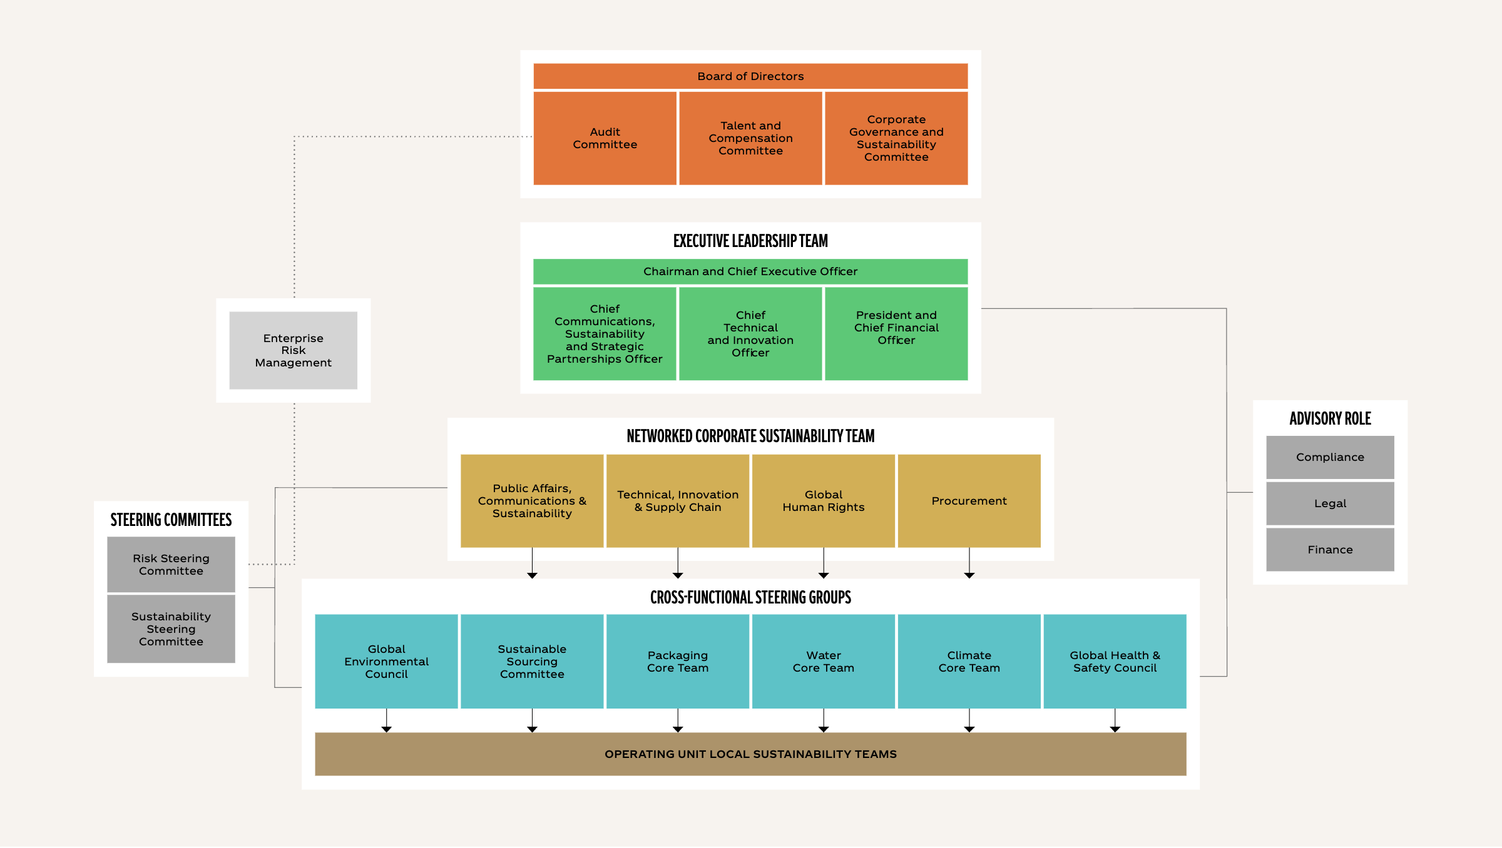
Governance framework

Slide 10

Sustainable Growth Metrics
Sustainable Agriculture
In 2022, 64% of our global priority ingredient volumes were sustainably sourced according to their Leader standard, aligning with the Principles for Sustainable Agriculture (PSA).
Water Management
We implemented advanced water management practices, particularly in water-stressed regions. We initiated projects to improve irrigation efficiency and agricultural practices, such as in Türkiye, where we launched a project to improve irrigation on approximately 500 acres of land growing apples, peaches, nectarines, and tomatoes.

Slide 11




Conclusion & Future
Innovative Solutions
Coca-Cola is committed to driving sustainable innovation through technology-led solutions, collaborating with partners to address pressing environmental and social challenges.
Continuous Improvement
The company is dedicated to continuously improving its sustainability efforts, setting ambitious goals, and working tirelessly to achieve them, with a focus on creating a better future for all.
Outlook
Coca-Cola will continue to drive sustainable development through innovation and collaboration. We believe that together, we can provide high-quality products while making a positive impact on our planet and communities.

Slide 12

References
https://www.coca-colacompany.com/social
Refinitiv
https://www.knowesg.com/esg-ratings/coca-cola
https://www.coca-colacompany.com/sustainability
https://www.csrwire.com/press_releases/803336-coca-cola-hbc-ey-ibm-g-esg
Team Company: Coca-Cola
Team Member: Chendong Yao, Fulei Zhang, Jiahao Zhang, Lingzhi Cao, Yilin Jiang
Team Name: Singapore
Date: 2024.6.13

